Slide 1
Five Minerals Powder
Five Minerals Powder (五石散), or Cold-Food Powder (寒食散), was a poisonous psychoactive drug popular during the Six Dynasties (220–589) and Tang Dynasty (618–907) periods of China.
Ingredients: stalactite(钟乳石), fluorite(紫石英), quartz(白石英), sulfur(硫磺), red halloysite(赤石脂)——《魏晋风度及文章与药及酒之关系》(鲁迅)

Slide 2
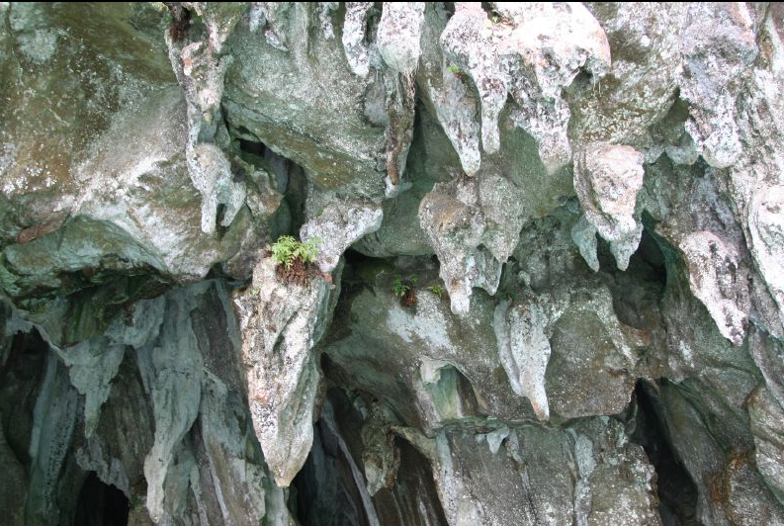
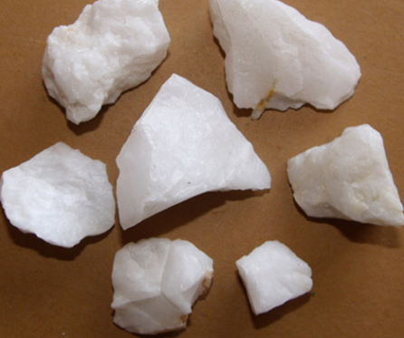
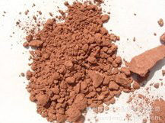
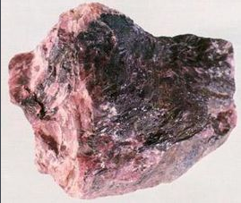
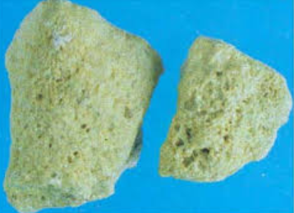
Five Minerals Powder
stalactite(钟乳石)
quartz(白石英)
red halloysite(赤石脂)
fluorite(紫石英)
sulfur(硫磺)

Slide 3
Five Minerals Powder
Effects:
Fever symptoms: Fever, needs “cold food”
Behavioural disorders: experience of depression and suicidal tendencies
Aphrodisiac(春药)

Slide 4
Five Minerals Powder
Skin troubles:
1. all kinds of "rottenness" of flesh;
2. cutaneous disorders like abscesses, ulcers, especially on the legs and on the back.

Slide 5
Five Minerals Powder
Influence on daily life:
Scholars generally associate the drug with the scholar-gentry social class
Wearing clogs（木屐） and loose clothes because their skin easily scraped
Prefer old clothes, many bugs on their body

Slide 6
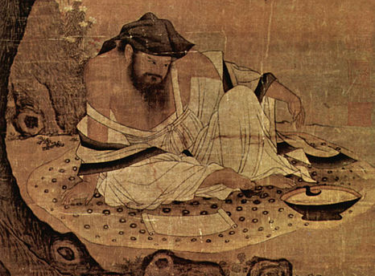
Tao Yuanming (365?–427)

